Slide 1

Power Enjoy
Accademic Year 2016/2017
RASD Presentation
Politecnico di Milano
Software Engineering 2
Simone Bruzzechesse
Luca Franceschetti
Gian Giacomo Gatti

Slide 2
introduction 1
The goal of our project is to design and develop a digital management system for car-sharing service.
This system employs exclusively electric cars.
The system should provide classic functionality provided by generic car-sharing service, like car’s reservation or payment
User can register into the system (through APP or web) by providing personal information
Through mobile application, registered user should be able to find a car within a certain distance from current location or from a specific address
The system provides also the possibility to reserve a single car

Slide 3
introduction 2
Car-sharing system initiates the charging of money as soon as the engine ignites, and the system starts charging the user for a given amount of money per minute
The user is notified of the current charges through a screen on the car
The system stops charging the user as soon as the car is parked in a safe area and the user exits the car
The set of safe areas for parking cars is predefined by the management system
The system should apply discounts on the trips

Slide 4
Actors
Guest: a guest is a person who is not registered in the system yet. He cannot use features of the system until he/she sign up.
User: a user is a person that has already signed up into the system. When a user logs in, we consider him/her as a LOGGED USER. The logged user can take advantage of every features of our system, and depending on what his actions are he/she can be a simple user or a driver.

Slide 5
assumption and dependencies 1
We deliver payment management to an external system, that manages exceptions such as user without enough money for the payment.
We assume that the fee is immediately payed as soon as the reservation expires
The payment of the trip is made as soon as the user leaves the car. It’s postponed whether user select the possibility to plug the car.
Since “the user leaves the car” and “the user is near the car” are ambiguous, we assume that a user is near the car or is leaving it if the distance (calculated from the two GPS) between them is smaller/bigger than a certain amount.

Slide 6
assumption and dependencies 2
We assume that the charging stations are always perfectly working or eventually immediately repaired.
Since we exactly know, thanks to Placemeter, how many people are actually in the car we assume discount of 10% will be applied only to part of the trip where the passengers were at least 2.
We assume that if one car’s charge is less than 5%, then it encourages the user to stop the trip as soon as possible. The car is charged by an employee of the system and then it’s available again for the users.

Slide 7
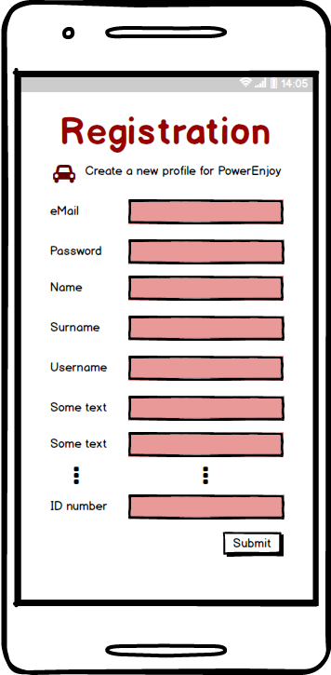
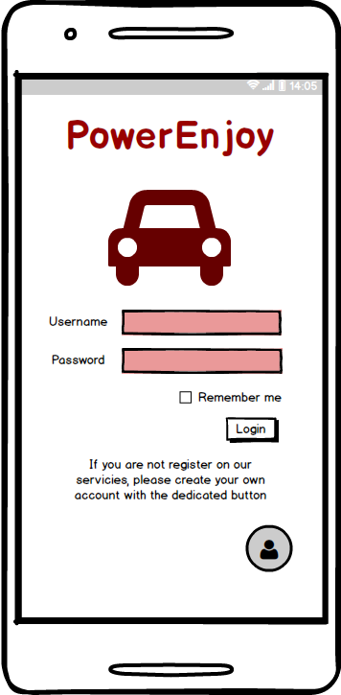
Mockups
Registration and login

Slide 8
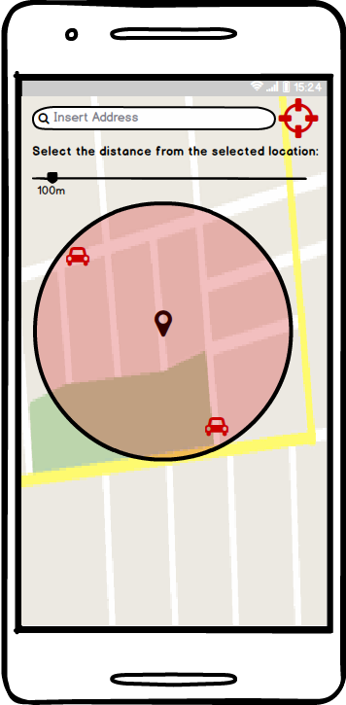
Mockups
Research a car

Slide 9
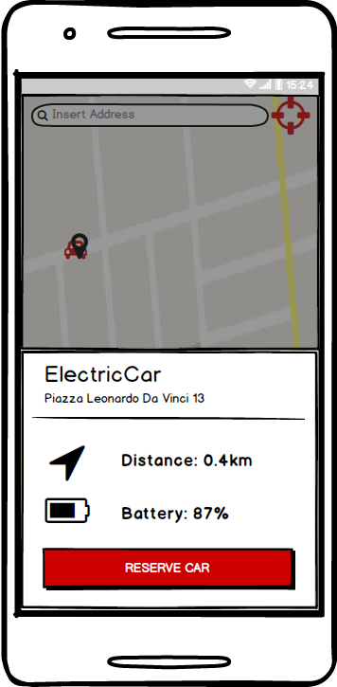
Mockups
Select a car, view status and reserve it

Slide 10
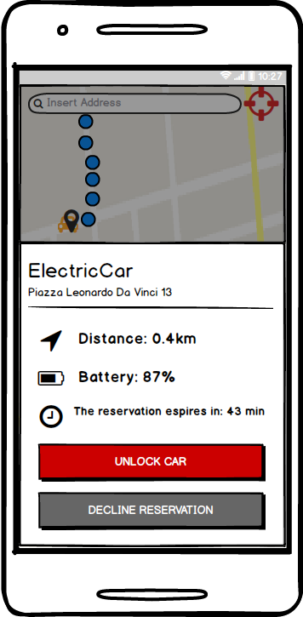
Mockups
Unlock the car

Slide 11
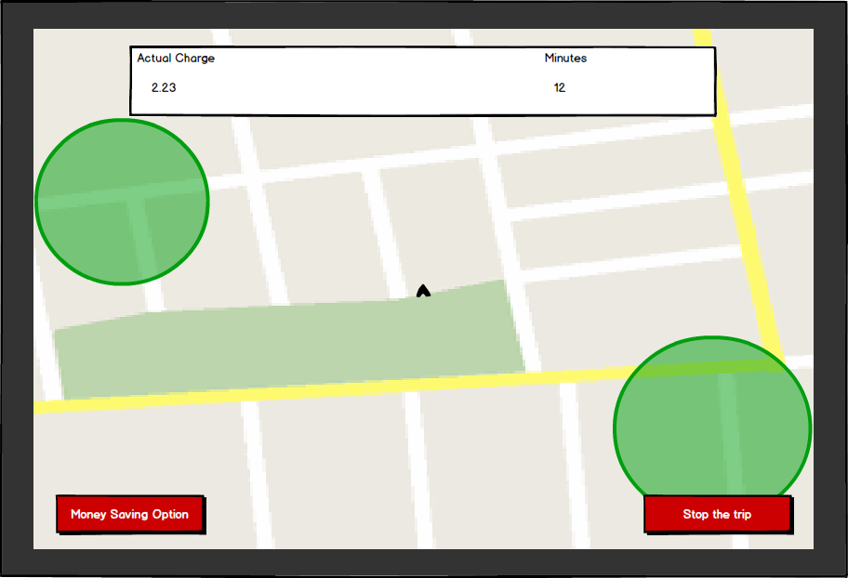
Mockups
View charge during the trip

Slide 12
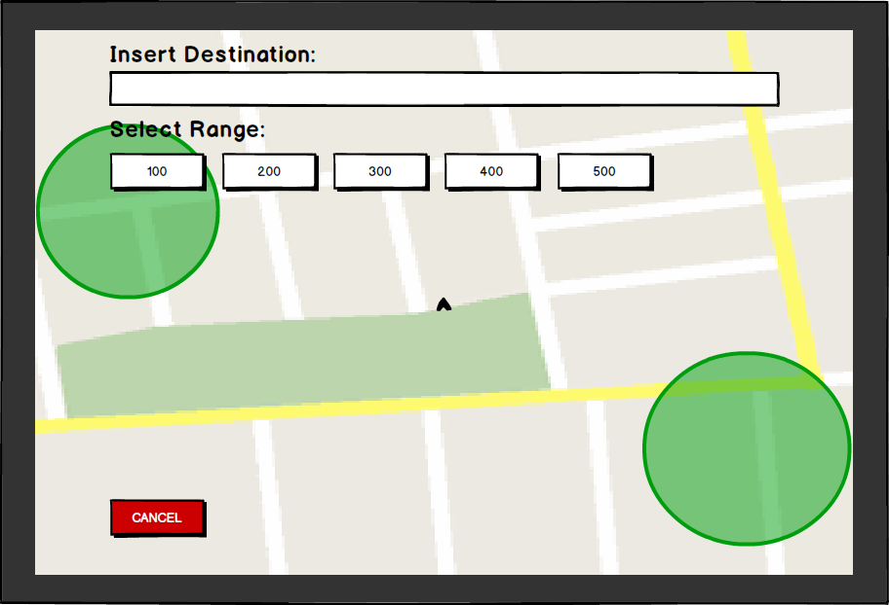
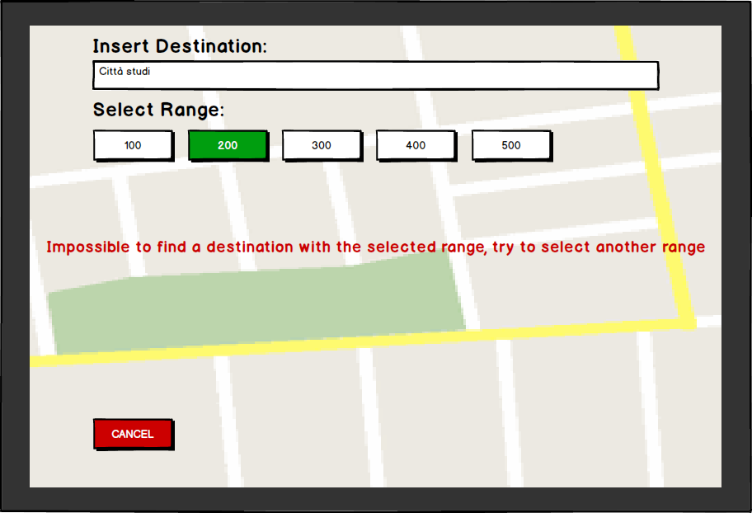
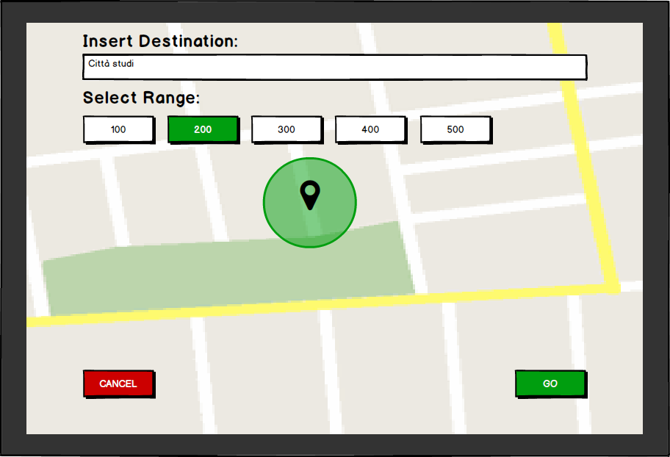
Mockups
Enable “money saving” option

Slide 13
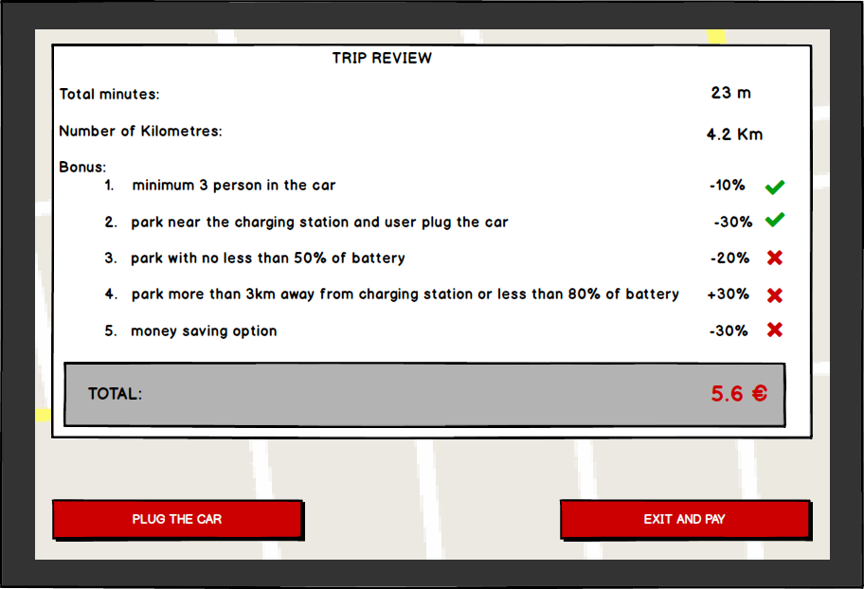
Mockups
Conclude the rent and pay

Slide 14
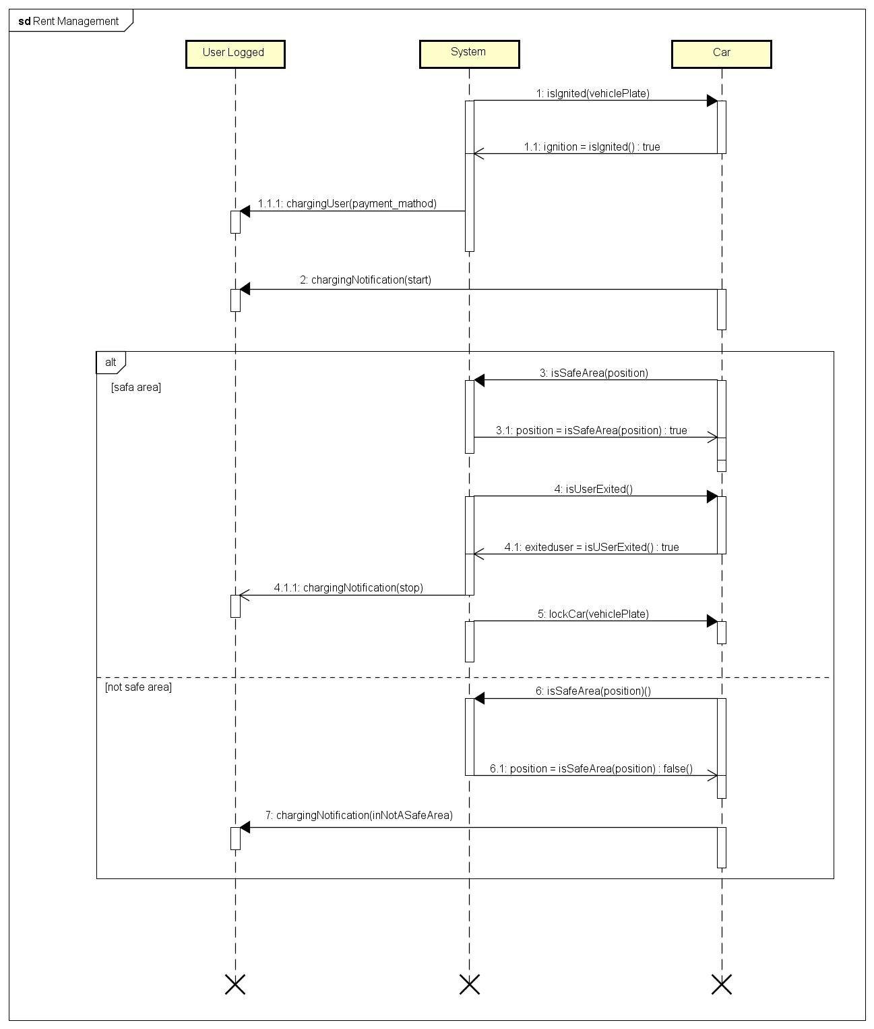
s
e
q
u
e
n
c
e
d
i
a
g
r
a
m

Slide 15
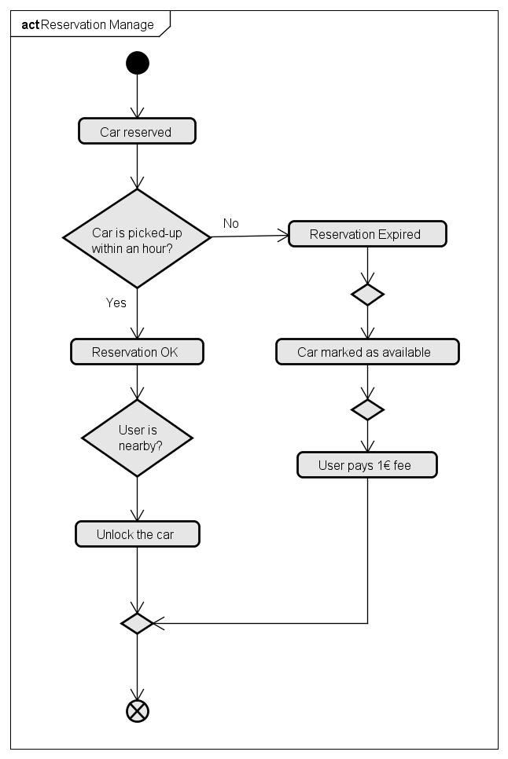
activity diagram

Slide 16
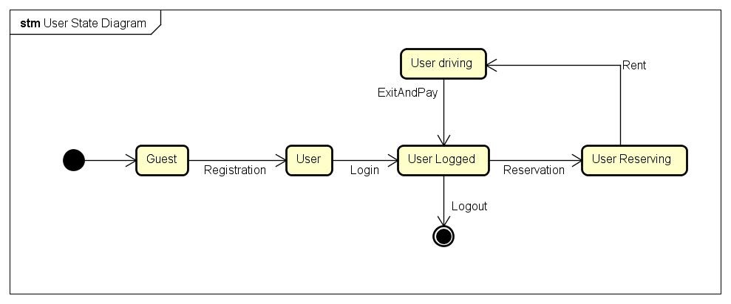
State diagram

Slide 17
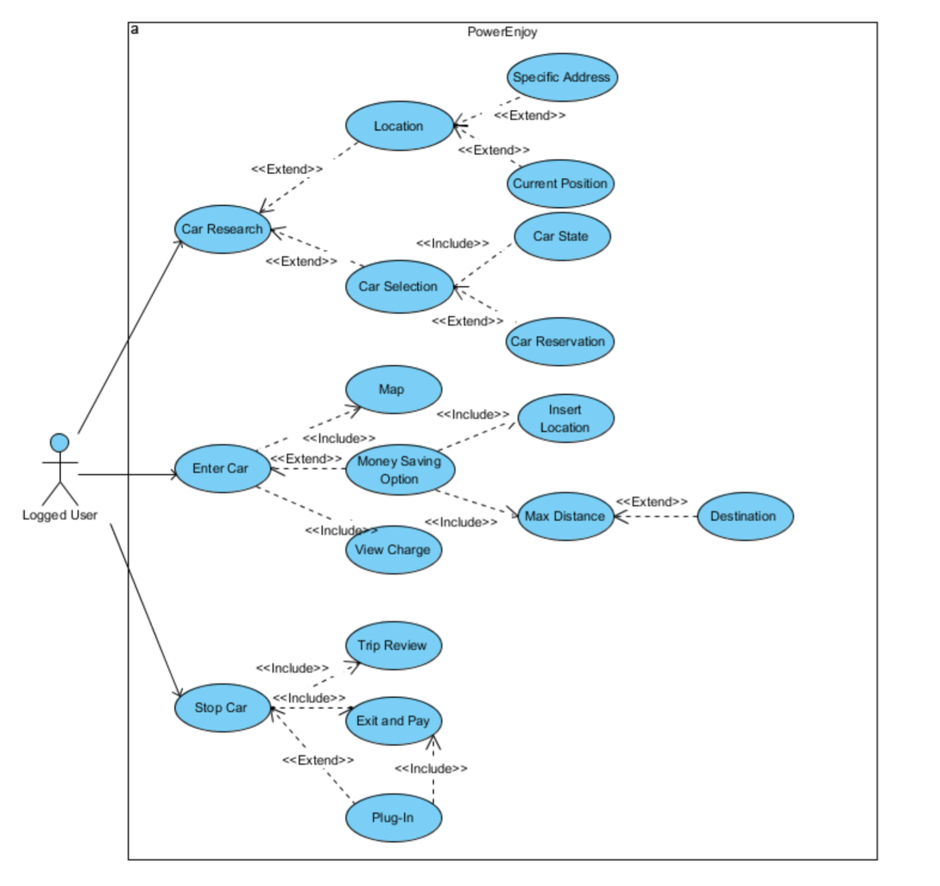
use case diagram

Slide 18
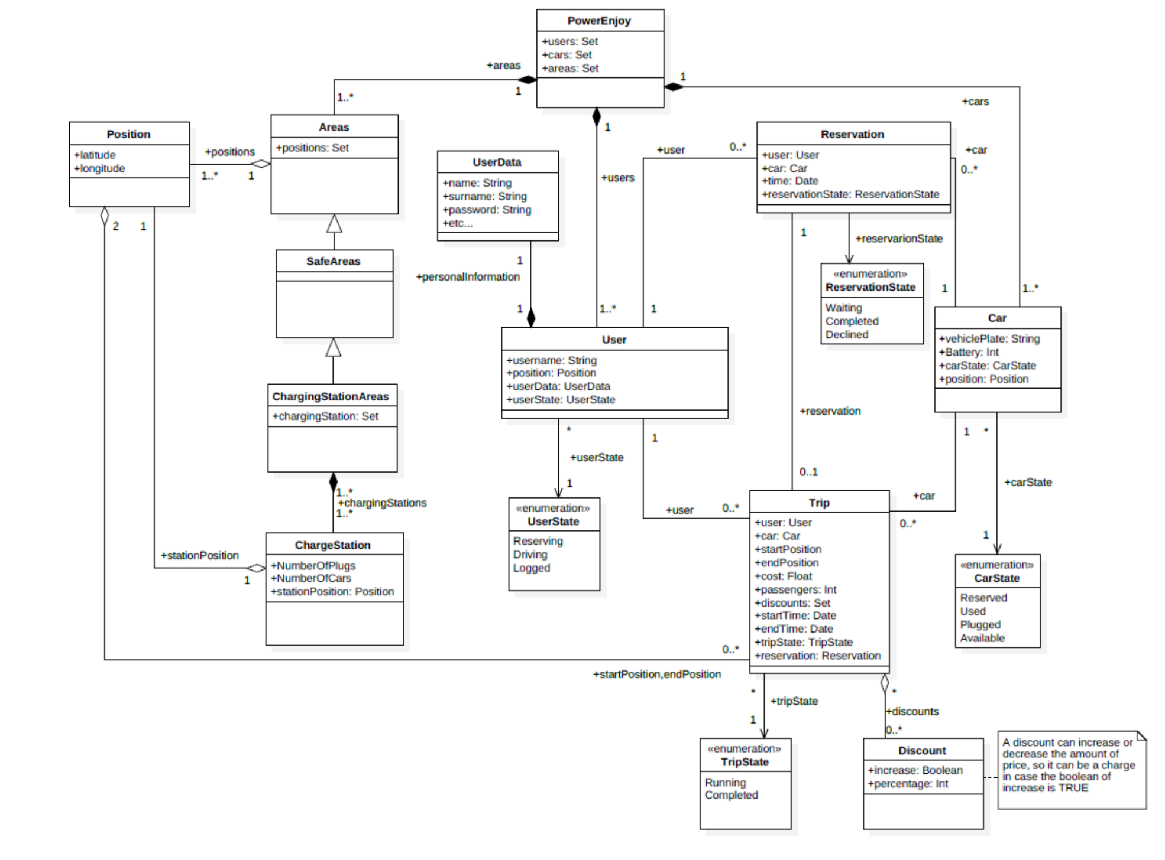
class diagram

Slide 19
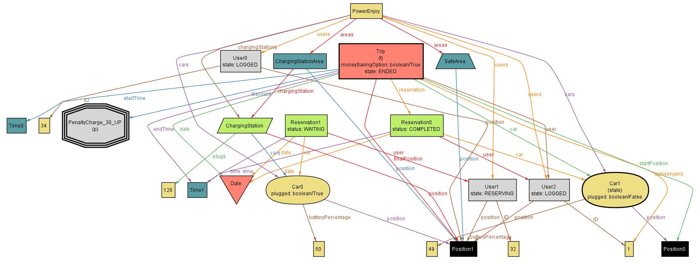
alloy model 1
Trip ended with discount

Slide 20
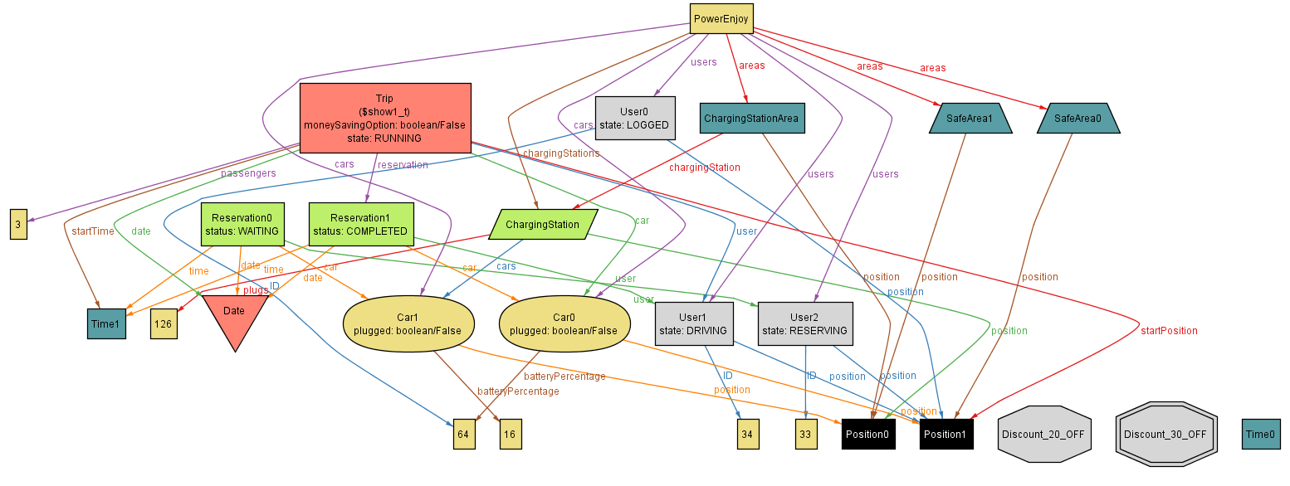
alloy model 2
Reservation waiting

